Slide 1

Spark Introduction
CSC 4760 / 6760 Big Data Programming
Spring 2020
Lightning-fast Cluster Computing Technology

Slide 2

Issues with MapReduce
One “template”: map, then reduce
HDFS is its own file system
In a data pipeline, each map-reduce step
Reads all input data from disk
Writes all output data to disk
Even if output is just an intermediate result
Simple programming model (MapReduce)
Scalable
Flexible
Fault-tolerant
Cost effective
Main concern: Speed
Waiting time between queries
Waiting time to run the program

Slide 3

Apache Spark
For speeding up the Hadoop computational time to run the program
Open source project out of AMPLab at UC Berkeley
A Spark program defines:
Transformations and actions on data sets
Data flow, or lineage graph among data sets, induced by the transformations
Data sets in Spark are called RDDs
Resilient Distributed Datasets

Slide 4
Hadoop and Spark
Spark is not a modified version of Hadoop
Spark is not dependent on Hadoop
Spark has its own cluster management
Hadoop is just one of the ways to implement Spark
Spark uses Hadoop in two ways
Storage (Only)
Processing (Own cluster management computation)

Slide 5
Spark Features
Main Feature: In-Memory Cluster Computing
Provide domain specific libraries
Example: map-reduce library
Promotes functional programming model
Access to multiple data (file) systems
Local, HDFS, Cassandra, S3, database tables, …
Lazy evaluation, and caching for performance
Reduce or eliminate disk I/O
Support multi-stage and iterative apps

Slide 6
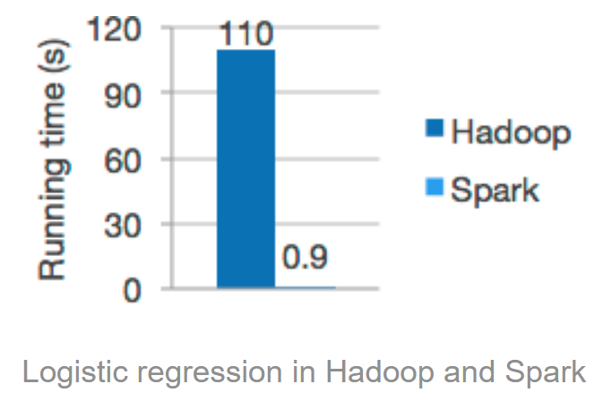
Spark Features
Main Feature: In-Memory Cluster Computing
Speed
Up to 100 times faster in memory than Hadoop
Up to 10 times faster when running on disk
Reducing the number of read/write operations to disk
Stores the intermediate processing data in memory
Supports multiple languages
Built-in APIs in Java, Scala, or Python
80 high-level operators for interactive querying
Advanced Analytics
Not only supports “Map” and “Reduce”
But also supports SQL queries, Streaming data, Machine Learning, and Graph Algorithms

Slide 7
Spark RDDs
Fundamental data structure of Spark
Read-Only
Partitioned collection of records
Resilient Distributed Dataset
One RDD has one or more (logical) partition
Partitions are Distributed/Computed across machines
Rebuilt from base data on failure (versus replication)
Lazy evaluation - created on demand
RDD types offer various functions (Any type of Python, Java, or Scala objects, including user-defined classes)
map, reduce
groupBy, reduceByKey
joins (inner, lePOuterJoin, rightOuterJoin)
filter, sample
RDD is the key idea of Spark
Spark uses RDD to achieve faster and efficient MapReduce operations

Slide 8
Creating RDDs
Fundamental data structure of Spark
Referencing a data in an external storage system
Shared File System
HDFS
HBase
Any data source offering a Hadoop Input Format
Parallelizing an existing collection in your driver program

Slide 9

RDD vs DFS vs RAID
Resilient Distributed Datasets (RDDs)
Distributed File System (DFS)
RAID, Redundant Array of Independent Disks
Storage servers with 24 hard disk drives and built-in hardware RAID controllers supporting various RAID levels

Slide 10
RDD vs DFS
Distributed File System (DFS) | Resilient Distributed Datasets (RDDs)
DFS stores data/files in persistent storage | in-memory storage and are not stored in any kind of persistent storage
If the data is lost from the DFS it is gone unless and until you have backup or replication setup | RDDs can be rebuilt in case of failure or if they are lost from memory
We do not build DFS from RDD. | RDDs can be created from a Distributed File System also. For example, if you have some data in a DFS somewhere, you can read that data from DFS and create an RDD in Spark to operate on that data.
https://www.quora.com/What-is-the-diffrence-between-Resilient-Distributed-Datasets-and-distributed-file-system

Slide 11
The Design of Spark
Cover a wide range of workloads
Batch applications
Iterative Algorithms
Interactive Queries
Streaming

Slide 12
Spark
Provides a higher level of abstraction for coding
Multi-stage map-reduce pipeline in Hadoop …
Can be composed functions in Spark
RDD support and libraries
Spark SQL - RDD representing relational table
Streaming data (real time) - D-Stream, Twitter stream
Graph data – GraphX
Spark Mllib (machine learning)
…

Slide 13
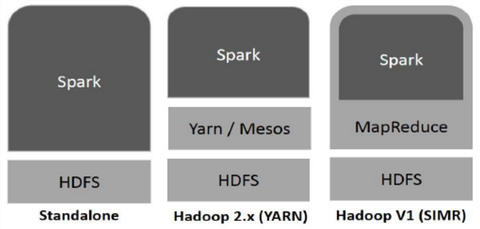
Spark Built on Hadoop
https://www.tutorialspoint.com/spark_sql/spark_sql_quick_guide.htm

Slide 14
Spark Built on Hadoop
Standalone
Spark occupies the place on top of HDFS
Space is allocated for HDFS explicitly
Spark and MapReduce will run side by side to cover all Spark jobs on cluster
Hadoop Yarn
Spark runs on Yarn without any pre-installation or root access required
Integrate Spark into Hadoop ecosystem
Spark in MapReduce (SIMR)
Launch spark job in attrition to standalone deployment
Start Spark and uses its shell without any administrative access
https://www.tutorialspoint.com/spark_sql/spark_sql_quick_guide.htm

Slide 15
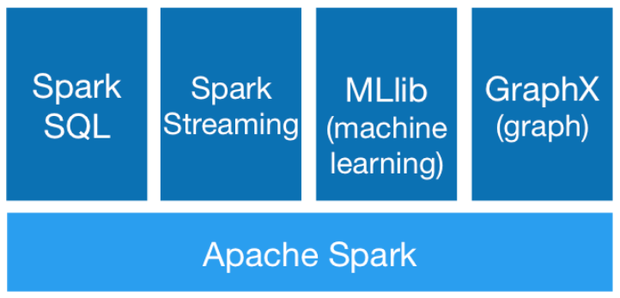
Components of Spark
https://www.tutorialspoint.com/spark_sql/spark_sql_quick_guide.htm

Slide 16
Components of Spark
Apache Spark Core
Underlying general execution engine for Spark platform that all other functionality is built upon
Provides In-Memory computing and referencing datasets in external storage systems
Spark SQL
Instroduces a new data abstraction called SchemaRDD
Provides support for structured and semi-structured data
Spark Streaming
Leverages Spark Core’s fast scheduling capability to perform streaming analytics
Ingests data in mini-batches and performs RDD transformation on theose mini-batches of data
https://www.tutorialspoint.com/spark_sql/spark_sql_quick_guide.htm

Slide 17
Components of Spark
MLlib (Machine Learning Library)
Distributed machine learning framework above Spark because of the distributed memory-based Spark architecture
Spark Mllib is nine times as fast as the Hadoop disk-based version of Apache Mahout
Apache Mahout: Scalable machine learning and data mining
GraphX
Distributed graph-processing framework on top of Spark
Provides an API for expressing graph computation that can model the user-defined graphs by using Pregel abstraction API
Also provides an optimized runtime for this abstraction
https://www.tutorialspoint.com/spark_sql/spark_sql_quick_guide.htm

Slide 18
Data Sharing is Slow in MapReduce
In the current MapReduce framework, the only way to reuse data between computations (two MapReduce jobs) is to Write it to an external stable storage system (e.g., HDFS)
Most of the Hadoop applications spend more than 90% of the time doing HDFS read-write operations.
Iterative and Interactive applications require faster data sharing across parallel jobs. In MapReduce, it is slow due to replication, serialization, and disk IO.

Slide 19
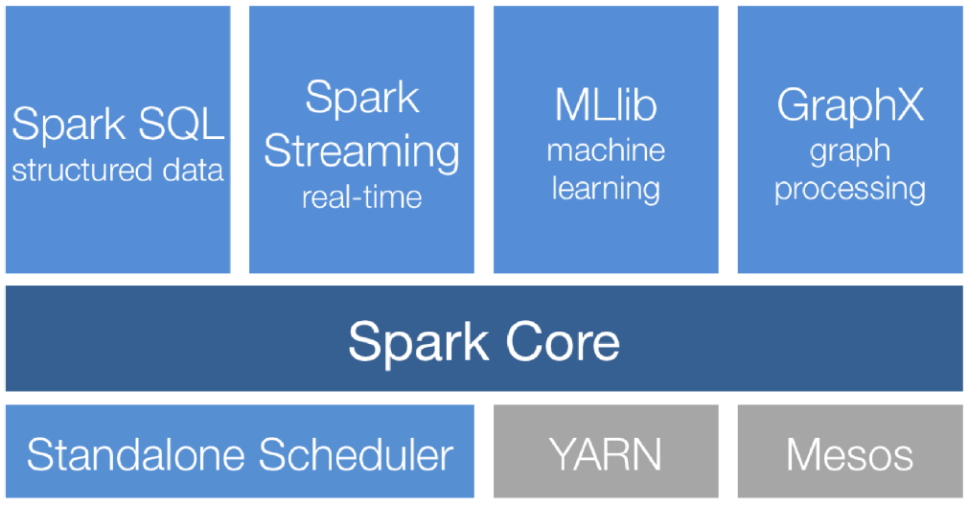
Spark Stack
Learning Spark, Figure 1-1.

Slide 20
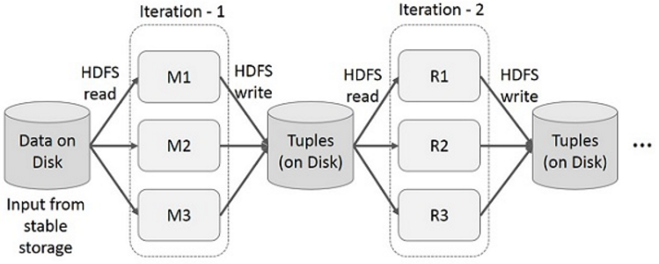
Iterative Operations on MapReduce
Reuse Intermediate results
slow
Overheads: data replication, disk I/O, serialization
https://www.tutorialspoint.com/spark_sql/spark_sql_quick_guide.htm

Slide 21
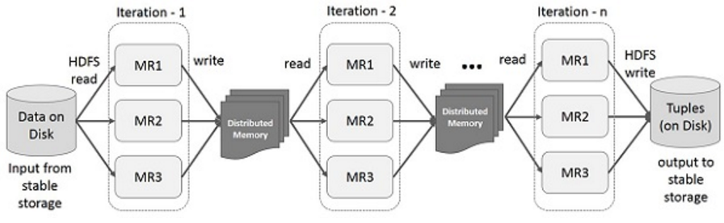
Iterative Operations on Spark RDD
Data sharing in memory is 10-100 times faster than network and disk.
If the distributed memory (RAM) is not sufficient to store intermediate results, then it will store these results on the disk.
https://www.tutorialspoint.com/spark_sql/spark_sql_quick_guide.htm

Slide 22
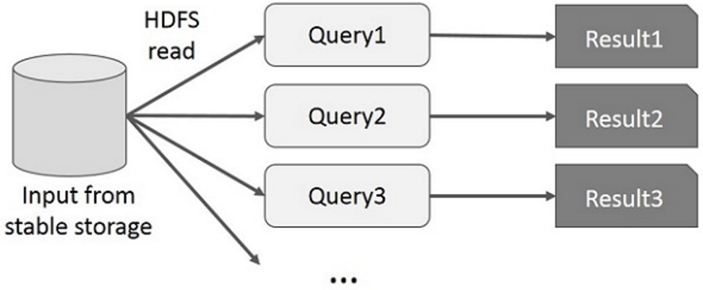
Interactive Operations on MapReduce
User runs ad-hoc queries on the same subset of data
Each query will do the disk I/O on the stable storage, which dominates the execution time
https://www.tutorialspoint.com/spark_sql/spark_sql_quick_guide.htm

Slide 23
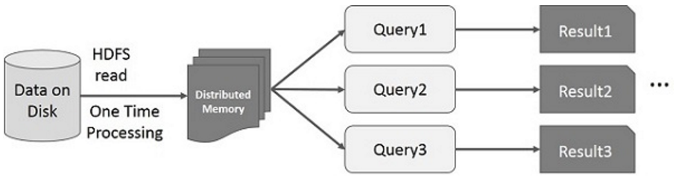
Interactive Operations on Spark RDD
If different queries are run on the same set of data repeatedly, this particular data can be kept in memory for better execution times.
Persist an RDD in memory;
Persist an RDD on disk, or replicated an RDD across multiple nodes
https://www.tutorialspoint.com/spark_sql/spark_sql_quick_guide.htm

Slide 24
Spark Program
RDDs
Input from external sources
Produced by a transformation
Transformations
Produce a new RDD from the input RDD
Actions
Compute something from the input RDD
Return non-RDD objects (e.g., number)
Write an RDD to external storage

